Slide 1
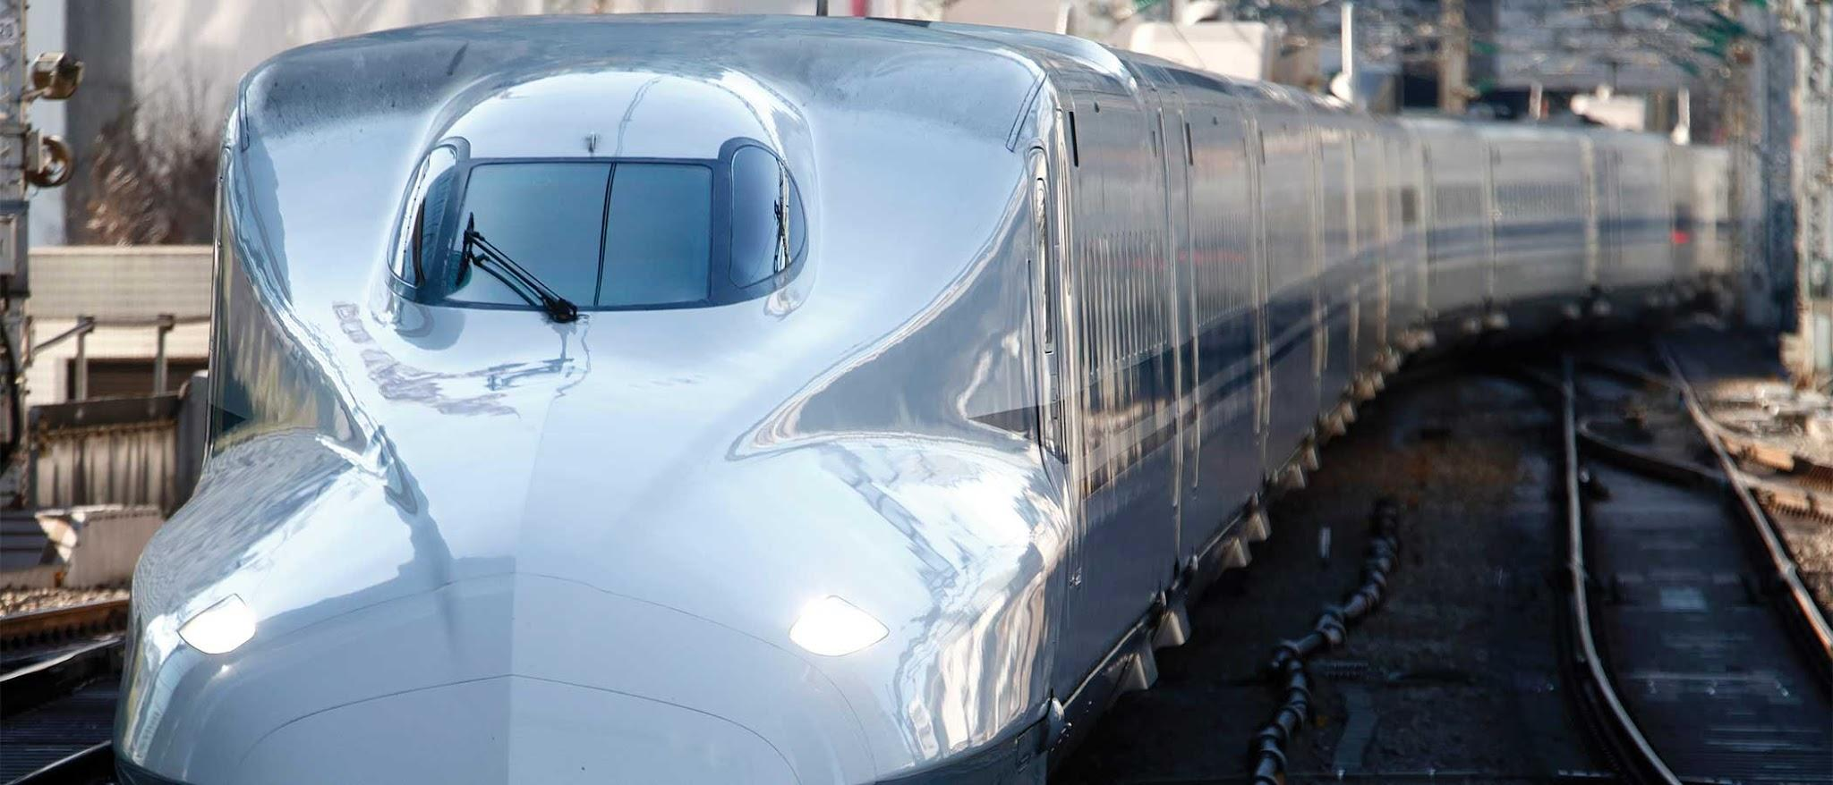
Project Drawdown:
Transportation

Slide 2
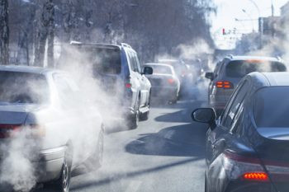
Problem Identification
Greenhouse Gas emissions
Vehicle reliance (equity)
Distance between suburbs and cities
High areas of traffic congestion
Airport congestion
State: Transportation accounts for 33% of greenhouse gas emissions
Symptoms: Global warming, pollution
Users: Commuters and Urban communities, anyone living on Earth
Stakeholders: Local government, environmental groups, urban planners, ect.
Success: Carbon neutral transportation by 2050

Slide 3
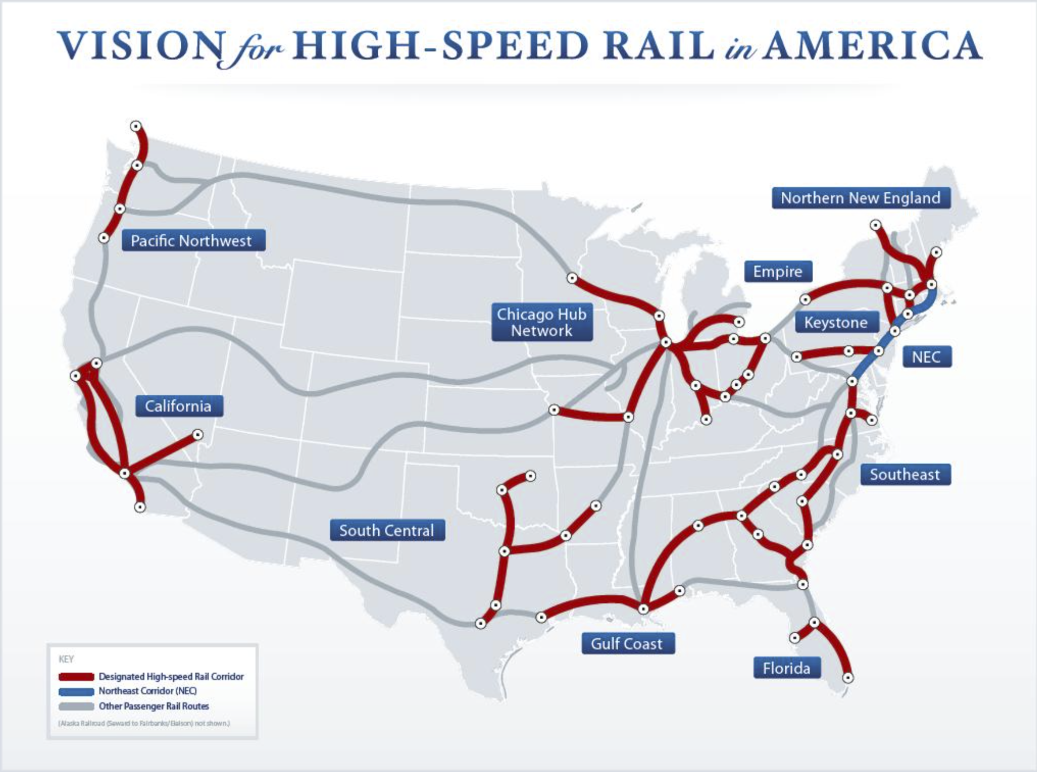
Solution: High Speed Rail!
Project Drawdown: “High-speed rail alleviates the need to use land for roads and highways.”
Reduces greenhouse gas emissions from commuter vehicles (“typical passenger vehicle emits about 4.6 metric tons of carbon dioxide per year” (US EPA))
Reduces need for clearing forests and leveling land for highways
High Speed rail has a capacity to carry more passengers per trip than commuter vehicles
Can reduce the need for short-haul flights, which reduces airport congestion
It’s an efficient alternative to reducing congestion on highways.
US High Speed Rail Association: “A single HSR line transports up to 20,000 people per hour (more than a 10-lane freeway + 2 airports), without delays or congestion.”
FRA vision published in 2009 (https://railroads.dot.gov/elibrary/high-speed-rail-strategic-plan)

Slide 4
Citations (APA)
Chen, W., et. al. (2023, August 12). High-speed rail @projectdrawdown #climatesolutions. Project Drawdown. https://drawdown.org/solutions/high-speed-rail
USHSR. (n.d.). Complete Transportation for America. SPA. https://www.ushsr.com/benefits/completetransportation/
Federal Railroad Administration. (2009, April 1). High-speed rail strategic plan. FRA. https://railroads.dot.gov/elibrary/high-speed-rail-strategic-plan
Kim, M. (2023, September 5). Why high-speed bullet trains won’t work in the U.S. right now. Scientific American. https://www.scientificamerican.com/article/why-high-speed-bullet-trains-wont-work-in-the-u-s-right-now/
THE U.S. NATIONAL BLUEPRINT FOR TRANSPORTATION DECARBONIZATION (A Joint Strategy to Transform Transportation)

